Slide 1
Data mining & Data Warehousing

Slide 2
Data
Data is distinct pieces of information, usually formatted in a special way. All software is divided into two general categories: data and programs. Programs are collections of instructions for manipulating data.
Data can exist in a variety of forms -- as numbers or text on pieces of paper, as bits and bytes stored in electronic memory, or as facts stored in a person's mind.

Slide 3
Information
.
The patterns, associations, or relationships among all this data can provide information. For example, analysis of retail point of sale transaction data can yield information on which products are selling and when
Knowledge
Information can be converted into knowledge about historical patterns and future trends. For example, summary information on retail supermarket sales can be analyzed in light of promotional efforts to provide knowledge of consumer buying behavior. Thus, a manufacturer or retailer could determine which items are most susceptible to promotional efforts.

Slide 4
Data Warehouses
Dramatic advances in data capture, processing power, data transmission, and storage capabilities are enabling organizations to integrate their various databases into data warehouses. Data warehousing is defined as a process of centralized data management and retrieval. Data warehousing, like data mining, is a relatively new term although the concept itself has been around for years. Data warehousing represents an ideal vision of maintaining a central repository of all organizational data. Centralization of data is needed to maximize user access and analysis. Dramatic technological advances are making this vision a reality for many companies. And, equally dramatic advances in data analysis software are allowing users to access this data freely. The data analysis software is what supports data mining.

Slide 5
What can data mining do?
Data mining is primarily used today by companies with a strong consumer focus - retail, financial, communication, and marketing organizations. It enables these companies to determine relationships among "internal" factors such as price, product positioning, or staff skills, and "external" factors such as economic indicators, competition, and customer demographics. And, it enables them to determine the impact on sales, customer satisfaction, and corporate profits. Finally, it enables them to "drill down" into summary information to view detail transactional data.

Slide 6
Data explosion problem
  Automated data collection tools and mature database technology lead to tremendous amounts of data stored in databases, data warehouses and other information repositories
We are drowning in data, but starving for knowledge!
Solution: Data warehousing and data mining
  Data warehousing and on-line analytical processing
  Extraction of interesting knowledge (rules, regularities, patterns, constraints) from data in large databases

Slide 7
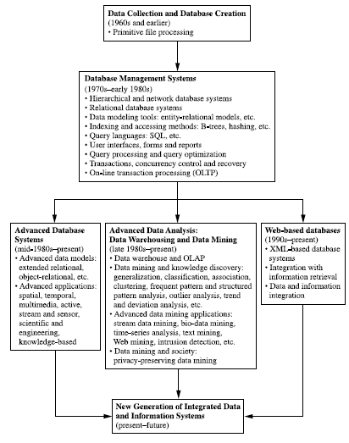
Evolution of Database Technology

Slide 8
Evolution of Database Technology
1960s:
  Data collection, database creation (primitive file processing)
1970s:
  Relational data model, relational DBMS implementation (SQL), OLTP
1980s:
  RDBMS, advanced data models (extended-relational, OO, deductive, etc.) and application-oriented DBMS (spatial, scientific, engineering, etc.)
1990s—present:
  Data mining and data warehousing, multimedia databases, and Web databases

Slide 9
Evolution of Database Technology
  Data warehouse is a repository multiple heterogeneous data sources organized under a unified schema at a single site in order to facilitate management decision making.
  Data ware house technology includes
  Other tools used for in-depth analysis
  Data cleaning
  Data integration
  Online Analytical Processing (OLAP)
  Supports Multidimensional Analysis
  Decision making

Slide 10
Evolution of Database Technology
  Other tools used for in-depth analysis
  Data classification tools
  Data Clustering tools
  Tools for characterization of data changes
  Data streams
  Data flows in and out like streams as in like video surveillance, telecommunication, sensor networks
  1990s-present
  XML based database systems

Slide 11
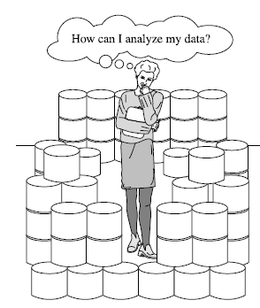

The fast-growing, tremendous amount of data, collected and stored in large and numerous data repositories
exceeded human ability for comprehension without powerful tools
data repositories become “data tombs”

Slide 12
Leads to decision making based not on information rich data in repositories than on decision maker’s intuition as he has no tools to extract the embedded knowledge
Expert systems are prone to biases and errors and extremely time consuming and costly
Data mining tools perform data analysis , uncover data patterns, help in decision making to business strategies, knowledge bases, scientific & medical researches , widening gap between data and information turns data tombs to golden nuggets of knowledge

Slide 13


What is Data Mining ?
Data mining refers to extracting or mining knowledge from large amounts of data.

Slide 14
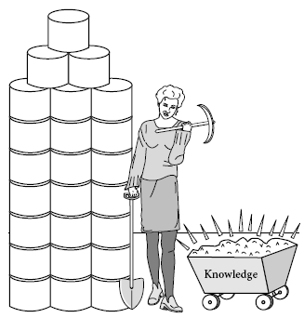
Data Mining …
Data mining (knowledge discovery in databases):
  Extraction of interesting , non-trivial, implicit, previously unknown and potentially useful information or patterns from data in large databases

Slide 15
Data Mining ?
Alternative names:
  Data mining: a misnomer ?
  Knowledge discovery(mining) from databases (KDD), knowledge extraction, data/pattern analysis, data archeology, data dredging, information harvesting, business intelligence, etc.
What is not data mining ?
  (Deductive) query processing
  Expert systems or small statistical programs

Slide 16
Data Mining: A KDD Process
Knowledge
  Data mining: the core of knowledge discovery process.
Evaluation & Presentation
Data Mining
Patterns
Task-relevant Data
Data Warehouse
Selection &
Transformation
Data Cleaning
Data Integration
Databases
Notes:
Data mining steps:
Data cleaning – integration – selection – transformation – mining – Pattern evaluation – knowledge presentation

Slide 17
Steps of a KDD Process
Data cleaning
- to remove noise and inconsistent data
2. Data integration
- where multiple data sources may be combined
3. Data selection
-where data relevant to the analysis task are
retrieved from the database
4. Data transformation
-where data are transformed or consolidated into
forms appropriate for mining by performing
summary or aggregation operations

Slide 18
Steps of a KDD Process
5. Data mining
- an essential process where intelligent methods are
applied in order to extract data patterns
6. Pattern evaluation
- to identify the truly interesting patterns representing
knowledge based on some interesting measures
7. Knowledge presentation
- where visualization and knowledge representation
techniques are used to present the mined
knowledge to the user

Slide 19
Steps of a KDD Process
Learning the application domain:
  relevant prior knowledge and goals of application
Creating a target data set: data selection
Data cleaning and preprocessing: (may take 60% of effort!)
Data reduction and transformation:
  Find useful features, dimensionality/variable reduction, invariant representation
Choosing functions of data mining
  summarization, classification, regression, association, clustering
Choosing the mining algorithm(s)
Data mining: search for patterns of interest
Pattern evaluation and knowledge presentation
  visualization, transformation, removing redundant patterns, etc.
Use of discovered knowledge

Slide 20
Data Mining and Business Intelligence
Increasing potential
to support
business decisions
Making
Decisions
End User
Data Presentation
Business
Analyst
Visualization Techniques
Data Mining
Data
Analyst
Information Discovery
Data Exploration
Statistical Analysis, Querying and Reporting
Data Warehouses / Data Marts
OLAP
DBA
Data Sources
Paper, Files, Information Providers, Database Systems, OLTP

Slide 21
Architecture of a Typical Data Mining System
Graphical user interface
Pattern evaluation
Data mining engine
Knowledge-base
Database or data warehouse server
Data cleaning , integration & selection
Data
Warehouse
Databases
Notes:
Databases, data warehouse, www, other information repositories

Slide 22
Components of a Data Mining System
Database, data warehouse, World Wide Web, or other
information repository: This is one or a set of
databases, data warehouses, spreadsheets, or other
kinds of information repositories. Data cleaning and data
integration techniques may be performed on the data.
Database or data warehouse server: The database or
data warehouse server is responsible for fetching the
relevant data, based on the user’s data mining request.
Knowledge base: This is the domain knowledge that is used to guide the search or evaluate the interestingness of resulting patterns. Such knowledge can include concept
hierarchies, and used to organize attributes into different levels of abstraction.
Notes:
Time related data are stored in a temporal database where the data is stored in relational databases.
The attributes may have several timestamps each having different semantic interpretation.
A time-series database stores a sequence of data that changes with time. (Ex: hourly, daily, weekly)
A dwh is a repository of information collected from multiple sources, stored under a unified schema, and that usually resides at a single site
DWH is enterprise- wide & Data mart is department-wide

Slide 23
- Here knowledge includes user beliefs to assess a pattern’s
interest based on its unexpectedness, additional
interesting constraints or thresholds, and metadata
(e.g. describing data from multiple heterogeneous
sources ).
Data mining engine: This is essential to the data mining
system and consists of a set of functional modules for tasks
such as characterization, association and correlation
analysis, classification, prediction, cluster analysis, outlier
analysis, and evolution analysis.
Notes:
Time related data are stored in a temporal database where the data is stored in relational databases.
The attributes may have several timestamps each having different semantic interpretation.
A time-series database stores a sequence of data that changes with time. (Ex: hourly, daily, weekly)
A dwh is a repository of information collected from multiple sources, stored under a unified schema, and that usually resides at a single site
DWH is enterprise- wide & Data mart is department-wide

Slide 24
Pattern evaluation module: This component uses interesting measures and interacts with the data mining modules to focus the search toward interesting patterns. It may use interestingness thresholds to filter out discovered patterns.
User interface:
- communicates between users and the data
mining system.
- allows the user to interact with the system by a
data mining query or task.
- provides information to help focus the search,
and performing exploratory data mining based
on the intermediate data mining results.
- allows the user to browse database and data
warehouse schemas, evaluate mined patterns,
and visualize the patterns in different forms.
Notes:
Time related data are stored in a temporal database where the data is stored in relational databases.
The attributes may have several timestamps each having different semantic interpretation.
A time-series database stores a sequence of data that changes with time. (Ex: hourly, daily, weekly)
A dwh is a repository of information collected from multiple sources, stored under a unified schema, and that usually resides at a single site
DWH is enterprise- wide & Data mart is department-wide

Slide 25
Data mining involves an integration of techniques from multiple disciplines such as database and data warehouse technology, statistics, machine learning, high-performance computing, pattern recognition, neural networks, data visualization, information retrieval, image and signal processing, and spatial or temporal data analysis…..
Notes:
Time related data are stored in a temporal database where the data is stored in relational databases.
The attributes may have several timestamps each having different semantic interpretation.
A time-series database stores a sequence of data that changes with time. (Ex: hourly, daily, weekly)
A dwh is a repository of information collected from multiple sources, stored under a unified schema, and that usually resides at a single site
DWH is enterprise- wide & Data mart is department-wide

